Slide 1
Computer System Overview

Slide 2
Input Devices
Keyboard.
Mouse.
Scanner.
Light pen.
Barcode Reader.
Microphone.
Touchscreen.
Joystick.

Slide 3
Output Devices
Monitors,
Printers,
Speakers,
Headphones,
Projectors,
GPS devices,
Optical mark readers and Braille readers.

Slide 4
CPU(Central Processing Unit)
A central processing unit (CPU), also called a central processor, main processor, or just processor, is the most important processor in a given computer.

Slide 5
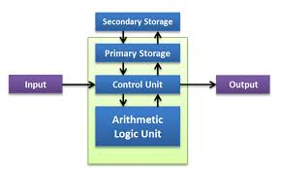
Components of a computer system

Slide 6
Functions of ALU and Control unit
The Arithmetic Logic Unit (ALU) is a digital circuit responsible for performing arithmetic and logic operations on data, while the Control Unit (CU) is responsible for coordinating and regulating the operation of the computer's other components, including the ALU.

Slide 7
Primary Storage
It is commonly used to store data or information on which the computer is presently working; therefore, we can call it a temporary storage device. When the systems are turned off, data and information are lost. Types of primary memory: RAM: Random Access Memory.

Slide 8
Secondary Storage
Secondary memory refers to the more permanent storage. Hard disks and flash drives are examples of secondary memory. Before instruction execution, a CPU component called the control unit is necessary for transferring data or instructions from secondary memory into main memory.

Slide 9
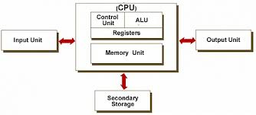
Basics of Computer Organisation

Slide 10
Input Devices
A piece of equipment/hardware which helps us enter data into a computer is called an input device. For example keyboard, mouse, etc.

Slide 11
Output Devices
A piece of equipment/hardware which gives out the result of the entered input, once it is processed (i.e. converts data from machine language to a human-understandable language), is called an output device. For example printer, monitor, etc.

Slide 12
Registers
Registers are a type of computer memory used to accept, store, and transfer data and instructions used by the CPU right away. Processor registers refer to the registers used by the CPU. During the execution of a program, registers are used to store data temporarily.

Slide 13
Memory Unit
A memory device refers to a device that can store data. The quantity of data stored in a unit of memory is called a memory unit. Furthermore, we quantify its storage capacity in bytes.

Slide 14
Main Memory
What is the main memory of a computer?
The main memory of a computer can also be called as primary memory. It is also known as Random Access Memory (RAM).

Slide 15
Contd…
The main memory of a computer can also be called as primary memory. it is also known as random access memory that is RAM . when computer is shut down all the data in RAM is erased. primary memory is computer memory that is accessed directly by the CPU .

Slide 16
RAM(Random Access Memory)
The full form of RAM is random access memory. It is a memory device that is located on the motherboard of a computer and is used as the area of memory where the computer temporarily stores its work. RAM is volatile, which means that the contents of memory can be erased when electricity is removed from it.

Slide 17
Features of Static RAM
Static random access memory has its importance as the memory of choice for cache memory. Here are some of its features.
SRAM has a lower access time, around ten nanoseconds.
It is much faster than DRAM as the memory cells do not require to be continuously refreshed.
However, it consumes more power since it uses a bi-stable latch circuit, and requires a regular power source.
It is costly and exists on the processors between the processor and main memory.
It is long-lasting.
As a part of the computer RAM, SRAM is entirely necessary but expensive.

Slide 18
DRAM
DRAM computer RAM is useful to have as a cheaper memory option. It usually serves as the main memory.
DRAM has a much higher access time of around 50 nanoseconds.
It is slower than SRAM because memory cells need to be continuously refreshed.
It consumes less power because the information is stored in one capacitor.
DRAM is less expensive than SRAM.
One memory cell is made up of one transistor and one capacitor so it occupies less space on the same-sized chip, providing you with more memory than an SRAM of similar size.
DRAM random access memory is the best cost-saving memory.

Slide 19
Types of ROM(READ ONLY MEMORY)
ROM comes in various types, each with its unique characteristics and applications. These include Programmable ROM (PROM), Erasable Programmable ROM (EPROM), Electrically Erasable Programmable ROM (EEPROM), and Mask ROM. Each type has specific features regarding programming, erasing, and data retention(the practice of storing data for a specific period of time).

Slide 20
PROM
A programmable read-only memory (PROM) is a form of digital memory where the contents can be changed once after manufacture of the device. The data is then permanent and cannot be changed.

Slide 21
EPROM
An EPROM (rarely EROM), or erasable programmable read-only memory, is a type of programmable read-only memory (PROM) chip that retains its data when its power supply is switched off. Computer memory that can retrieve stored data after a power supply has been turned off and back on is called non-volatile.

Slide 22
EEPROM
EEPROM stands for Electrically Erasable Programmable Read Only Memory. This type of ROM can be erased and programmed with the help of an electric pulse.

Slide 23
Cache Memory
To speed up the operations of the CPU, a very high speed memory is placed between the CPU and the primary memory known as cache . It stores the copies of the data from frequently accessed primary memory locations , thus, reducing the average time required to access data from primary memory.

Slide 24
Contd...
Secondary memory is where programs and data are kept on a long-term basis. Common secondary storage devices are the hard disk and optical disks. The hard disk has enormous storage capacity compared to main memory. The hard disk is usually contained inside the case of a computer.

Slide 25
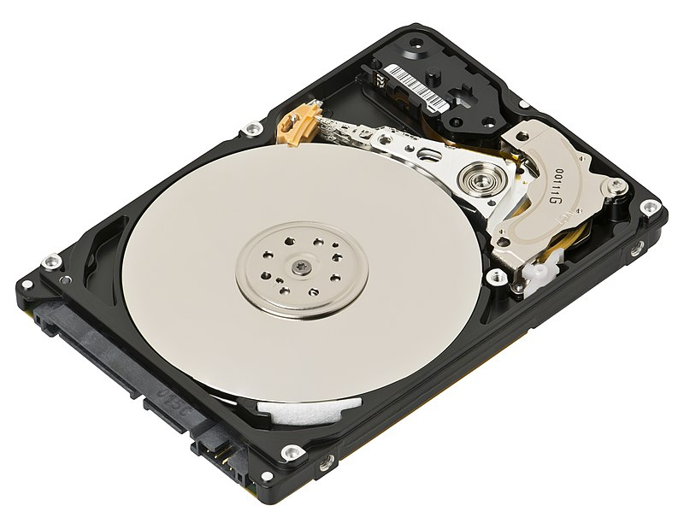
Harddisk

Slide 26
Contd...
A hard disk drive consists of a rigid disc made with non-magnetic material, which is coated with a thin layer of magnetic material. Data is stored by magnetizing this thin film. The disk spins at a high speed and a magnetic head mounted on a moving arm is used to read and write data.

Slide 27
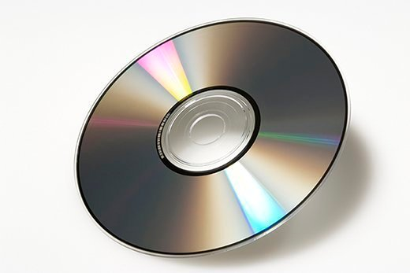
Compact Disc

Slide 28
CD(Compact Disc)
A compact disc is a portable storage medium that can record, store and play back audio, video and other data in digital form.

Slide 29
Types of Compact Disk
There are three main types:
(i) CD-ROM –(Compact Disk –Read Only Memory)
This is used to store information and cannot be used to store data.It is mainly used for CD distribution. For eg Software,Games,e-books etc.
(ii)CD-R (Compact Disk Recordable) –It is mainly used for CD-R and can be written on only once and disk can’t be erased.

Slide 30
Contd...
(iii) CD-RW(Compact Disk Rewritable)
CD-RW is an erasable disk you can write on multiple times.

Slide 31
DVD
The correct answer is Digital Versatile Disc. DVD, also known as Digital Versatile Disc or Digital Video Disc, is an optical disc storage media format. It was developed and invented in 1995 by Sony, Panasonic, and Samsung. Its main use is to store video and data.

Slide 32
Types of DVD
DVD media comes in several formats; including DVD+R (recordable DVD), DVD+RW (re-writeable DVD), DVD-RAM (random access memory) and DVD-ROM (read only memory).

Slide 33
Flash Memory
A flash drive is a small,ultra-portable storage device with a “Solid State” memory. For eg It has no moving parts inlike magnetic storage devices,nor does it make use of lasers-unlike optical drives.
The key difference is that data is retained in flash memory even the power is switched off.
They are now fairly inexpensive,costing from 250 /-
Typical sizes range from 256 Mbytes up to 128 GB and beyond.

Slide 34
Blu Ray Disk
Blu-ray Disc (also known as Blu-ray or BD) is an optical disc storage media format.Its main uses are high –definition video and data storage.
The disc has the same dimensions as a standard DVD or CD.
While current optical disc technologies such as DVD,DVD(add or minus)R,DVD(add or minus) RW and DVD-RAM rely on a red laser to read and write data,the new format uses a blue violet laser instead,hence the name Blu-ray.
This allows data to be packed more thighly and stored in less space,so it’s possible to fit more data on the disc even though it’s the same size as a CD/DVD.Blu Ray disks of today are capable of storing upto 128 GB of data.

Slide 35
The System Bus
The system bus (or the bus) is an electronic pathway composed of connecting cables and that connects the major components of a computer system.Though system bus,data and instructions are passed among the computer system components.
The data carrying part of system bus is called data bus.
The control instruction carrying part of system bus is called control bus.
The memory address carrying part of system bus is called Address bus.
A separate type of bus called I/O Bus connects the Input,Output and other external devices to the system.

Slide 36
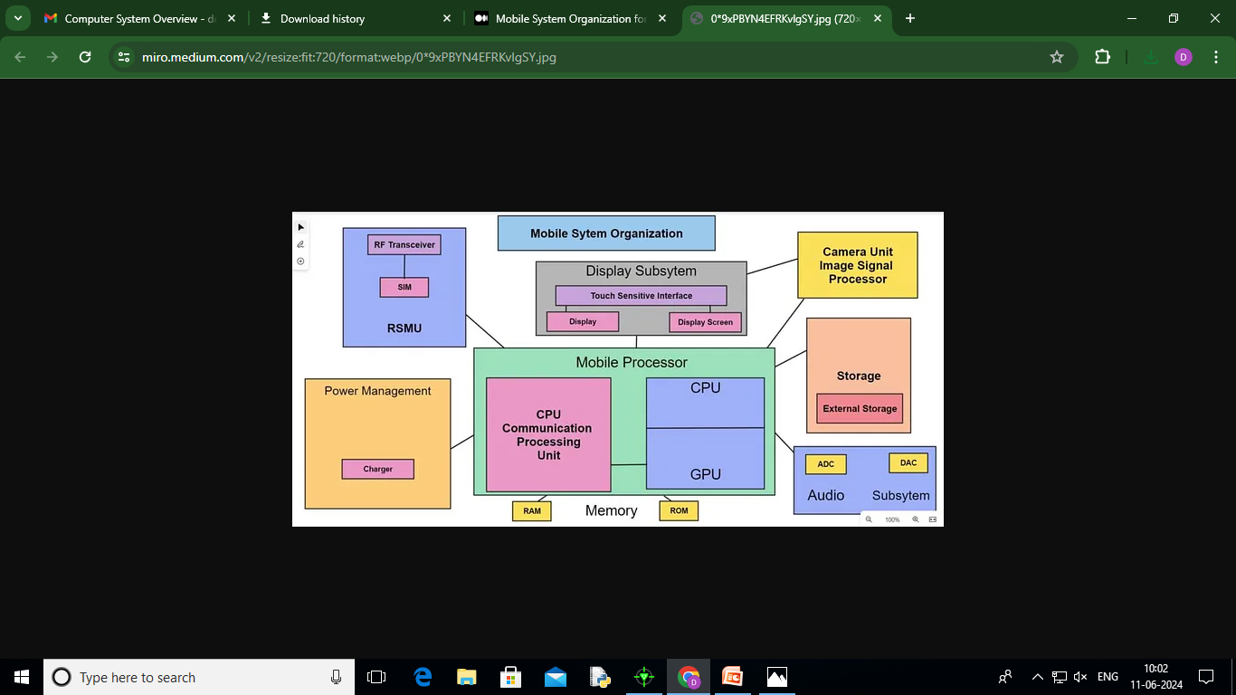

Slide 37
Mobile System Organization
Some of the important parts of the mobile are -:
Mobile Processor -> It means the brain of the mobile.
Camera ISP -> the part which processes the images and videos.
Display Unit -> provides display & touch interface to us.
Memory Unit -> storage unit of the mobile
Power Management/Battery Management -> battery of the mobile.
External Storage -> also considered as expandable storage.

Slide 38
Mobile Processor
Mobile Processor
The mobile processor is the CPU (Central Processing Unit) of our mobile. It processes a million of command per second.
It provides the backbone to our mobile phone, due to which, the Operating system of our mobile works, and all the pre-installed as well as installed application works, the Processor receives the command, then processes it, and then forms an output.

Slide 39
Contd…
Also, it performs all the calculations as same as the CPU. Without the processor, our mobile is unable to open and perform its functions.
Thus, the Processor is a very important device for our mobile. It is mainly divided into three parts which are -:
CPU — Communication Processing Unit
APU — Application Processing Unit
GPU — Graphical Processing Unit

Slide 40
CPU
CPU
It is also known as DSP (Digital Signal Processor). because it converts analog signals into digital signals.
It stands for Communication Processing Unit, As the name suggests that it is that part of the Mobile Processor which helps us to make and receive calls.
We could call each other because of this part of the processor.
It is also divided into two parts, which are -:
RSMU (Radio Signal Management Unit)
Audio Subsystem

Slide 41
APU and GPU
APU
APU stands for Application Processing Unit. As its name suggest that it is part of the mobile processor which runs all the applications (pre-installed and installed by the user).
APU executes every application, which is on the mobile.
GPU
GPU is the second part of the Mobile Processor. It stands for Graphical Processing Unit.
It is that part of the mobile processor that processes our mobile’s graphics and designs.
The more the quality of the GPU, the more we will get high-quality graphics.

Slide 42
Camera ISP
Now, in this section, we are going to read about the camera ISP. Here, ISP stands for Image Signal Processing.
It is that part of our mobile system which processes the images and videos. All the images, and videos that are taken from our camera, are part of this camera ISP.
It has a special image signal processor which processes the things like instant image capturing, high-resolution support, image stabilization, and image enhancements.

Slide 43
Display unit
Display Unit
This unit is not in the Mobile System Organization for class 11. But it is important to read this.
Display Unit is that unit of the mobile phone which provides us display & touch interface. We could scroll our mobile phones because of this unit only.
Most mobiles use an OLED display. Because, it has a very smooth and fast processing as well as it could be scrolled easily.

Slide 44
Memory Unit
The memoryUnit means the part of the mobile which stores the data, files, and information in it.
It also processes the data. It stores text documents, images, videos, pictures, songs, etc. In mobiles, there are mainly two types of memory, which are -:
RAM — Random Access Memory
ROM — Read Only Memory

Slide 45
RAM
It is the main working memory of our mobile. All the installed applications are first loaded on RAM, and after that, they were executed.
If our mobile phone will have better RAM, then its processing power will also be better. RAM is unable to work if the power supply of the electricity goes off.
This means it is a volatile memory.

Slide 46
ROM
It stands for reading Only Memory. It is the internal storage of the mobile.
No user could write anything on it, and thus it sounds like “Read Only”. ROM part of the memory resides near the Operating System of the mobile.
In ROM, some apps could not be deleted by the user’s end. Examples — WhatsApp, YouTube, Gmail, etc.

Slide 47
Power Management
Power Management means that part of the mobile supplies the power to the mobile, due to which the mobile phone could work and process.
Batteries are that part, because of which mobile works.
Most phones are formed with Lithium (Li+) ion batteries. The capacity of the battery is measured in MAh.
MAH stands for Milliampere-hour. The more the capacity of the battery, the more mobile could work.

Slide 48
External Storage
External Storage is also known as Expandable Storage. It means that storage which could be externally added to mobile phones.
It can be removed and added easily. There are many devices these days, for example — SD cards, Micro SD cards, etc.
We could store here text documents, images, videos, pictures, songs, etc. It is somewhat similar to Secondary Memory in computers.

Slide 49
Advantages of Mobile System
In this section, we are going to read some of the main advantages of mobiles, which are -:
Mobiles are small computers, which can process a large set of data within a second.
We could connect to the internet through our mobile phones.
We could easily communicate in any place on the earth.
We could capture images, and videos from our mobile phones, and edit them.

Slide 50
TYPES OF SOFTWARE
Software is a set of instructions or programs that tell a computer what to do. It is generally divided into two main categories:
System Software
The software that controls internal computer operations (reading data from input devices,transmitting processed information to the output devices,checking system components,converting data/instructions to computer understandable form etc.)is known as system software.
The system software can further be classified into two categories:
1.Operating System 2.Language Processor

Slide 51
Operating System
An operating system is a program which acts as an interface between a user and the hardware (all computer resources).
The primary goal of an operating system is to make the computer system convenient to use and secondary goal is to use computer hardware in an efficient manner.
An operating system is an important component of a computer system which controls all other component of a computer system which controls all other components of the computer system.Major components of a computer system are:
1.The Hardware 2.The Operating System(OS)
3.The Application Program routines(compiler,database management systems,utility programs)
4.The Humanware(users)

Slide 52
As soon as a computer is booted up,OS is loaded on RAM so that it can execute programs and applications and manage other resources of computer.
There are different types of operating systems
Refer pg no 10

Slide 53
Language Processors/Language Translators
A language processor is a special type of a computer software that can translate the source code into an object code or machine code.
A source code refers to the program code written by programmer in a high level programming language(HLL) such as in C,Java,C++ etc
A object code refers to a code usually in machine language or binary code,a language that computer can understand easily run on hardware.

Slide 54
Three types of language processors
Assembler-This language processor converts the program written in assembly language into machine language.
Interpreter-An interpreter is a type of system software that translates and executes instructions written in a computer program line by line ,unit by unit.
Compiler-A compiler is another type of system software that translates and executes instructions written in a computer program in one go.
Translated machine code runs fast(faster execution time) as now computer does not require any type of conversion to run it unlike source code which requires conversion into object /machine code before it can be executed.

Slide 55
Application Software
An application software is the set of programs necessary to carry out operations for a specified application.
This type of software pertains to one specific application.For instance a software that can perform railway reservation functions cannot prepare result for a school.
These are the programs written by programmers to enable computer to perform a specific task such as processing words, inventory control, handling calculations and figures,medical accounting,financial accounting ,result preparation,railway reservation,billing
Application software can further be sub divided into four categories:
1.Packages 2.Utilities 3.customised software 4.Developer Tools

Slide 56
2. Application Software
These are programs designed for end-users to perform specific tasks.
Types:
General Purpose Software – Used for common tasks.
  Example: MS Word (for typing), MS Excel (for spreadsheets), Web browsers.
Specialized Software – Designed for specific professions.
  Example: Tally (for accounting), AutoCAD (for engineers), Photoshop (for designers).
Custom Software – Created for a specific organization or user.
  Example: Software developed for a particular school or hospital.

Slide 57
PACKAGES
General Application software are known as packages.
Some major and common categories of general application software(packages) are:
(i) Word processing Software
(ii) Spreadsheets
(iii)Database Management systems
(iv)Desktop Publishing Software
(v) Graphics, multimedia and presentation applications.

Slide 58
UTILITIES
Utilities are those application programs that assist the computer by performing housekeeping functions like backing up disk or scanning /cleaning viruses or arranging information.
Text Editor-This utility program is used for creating ,editing text files.
Backup Utility –This utility program facilitates the backing up of disk .Back-up means duplicating the disk information so that in case of any damage or data-loss, this backed up data may be used.
Disk Defragmenter-A file is fragmented (stored at different locations) when it becomes too large for your computer to store in a single location on a disk. Fragmented files slow down a computer.

